Slide 1


Slide 2




INTRODUCTION TO BITCOIN CRYPTOCURRENCY
 | Crypto What? – Cryptocurrency is a new type of digital currency that's an alternative to the US dollar and other traditional currencies. Bitcoin was created in 2009 and is the largest and oldest cryptocurrency.
 | Put on Your Thinking Cap – Bitcoin is created when programmers solve complex computations that are added to the blockchain—the public ledger that records all Bitcoin transactions. This process, known as mining, requires a lot of time and significant computing power.
 | Finite Supply Creates Scarcity – The maximum number of Bitcoins that will be created through mining is 21 million. As of February 2023, there are about 1.9 million Bitcoins left to be mined.1 This finite supply is one reason why some people believe Bitcoin will eventually increase in value over time.
Don't Lose Your Password! – Around 20% of Bitcoin, valued at approximately $140 billion, is lost forever because people forgot their passwords.

Slide 3
INTRODUCTION TO BITCOIN CRYPTOCURRENCY
 | Crypto What? – Cryptocurrency is a new type of digital currency that's an alternative to the US dollar and other traditional currencies. Bitcoin was created in 2009 and is the largest and oldest cryptocurrency.
 | Put on Your Thinking Cap – Bitcoin is created when programmers solve complex computations that are added to the blockchain—the public ledger that records all Bitcoin transactions. This process, known as mining, requires a lot of time and significant computing power.
 | Finite Supply Creates Scarcity – The maximum number of Bitcoins that will be created through mining is 21 million. As of February 2023, there are about 1.9 million Bitcoins left to be mined.1 This finite supply is one reason why some people believe Bitcoin will eventually increase in value over time.
Don't Lose Your Password! – Around 20% of Bitcoin, valued at approximately $140 billion, is lost forever because people forgot their passwords.

Slide 4
INTRODUCTION TO BITCOIN CRYPTOCURRENCY
 | Crypto What? – Cryptocurrency is a new type of digital currency that's an alternative to the US dollar and other traditional currencies. Bitcoin was created in 2009 and is the largest and oldest cryptocurrency.
 | Put on Your Thinking Cap – Bitcoin is created when programmers solve complex computations that are added to the blockchain—the public ledger that records all Bitcoin transactions. This process, known as mining, requires a lot of time and significant computing power.
 | Finite Supply Creates Scarcity – The maximum number of Bitcoins that will be created through mining is 21 million. As of February 2023, there are about 1.9 million Bitcoins left to be mined.1 This finite supply is one reason why some people believe Bitcoin will eventually increase in value over time.
Don't Lose Your Password! – Around 20% of Bitcoin, valued at approximately $140 billion, is lost forever because people forgot their passwords.

Slide 5
INTRODUCTION TO BITCOIN CRYPTOCURRENCY
 | Crypto What? – Cryptocurrency is a new type of digital currency that's an alternative to the US dollar and other traditional currencies. Bitcoin was created in 2009 and is the largest and oldest cryptocurrency.
 | Put on Your Thinking Cap – Bitcoin is created when programmers solve complex computations that are added to the blockchain—the public ledger that records all Bitcoin transactions. This process, known as mining, requires a lot of time and significant computing power.
 | Finite Supply Creates Scarcity – The maximum number of Bitcoins that will be created through mining is 21 million. As of February 2023, there are about 1.9 million Bitcoins left to be mined.1 This finite supply is one reason why some people believe Bitcoin will eventually increase in value over time.
Don't Lose Your Password! – Around 20% of Bitcoin, valued at approximately $140 billion, is lost forever because people forgot their passwords.

Slide 6
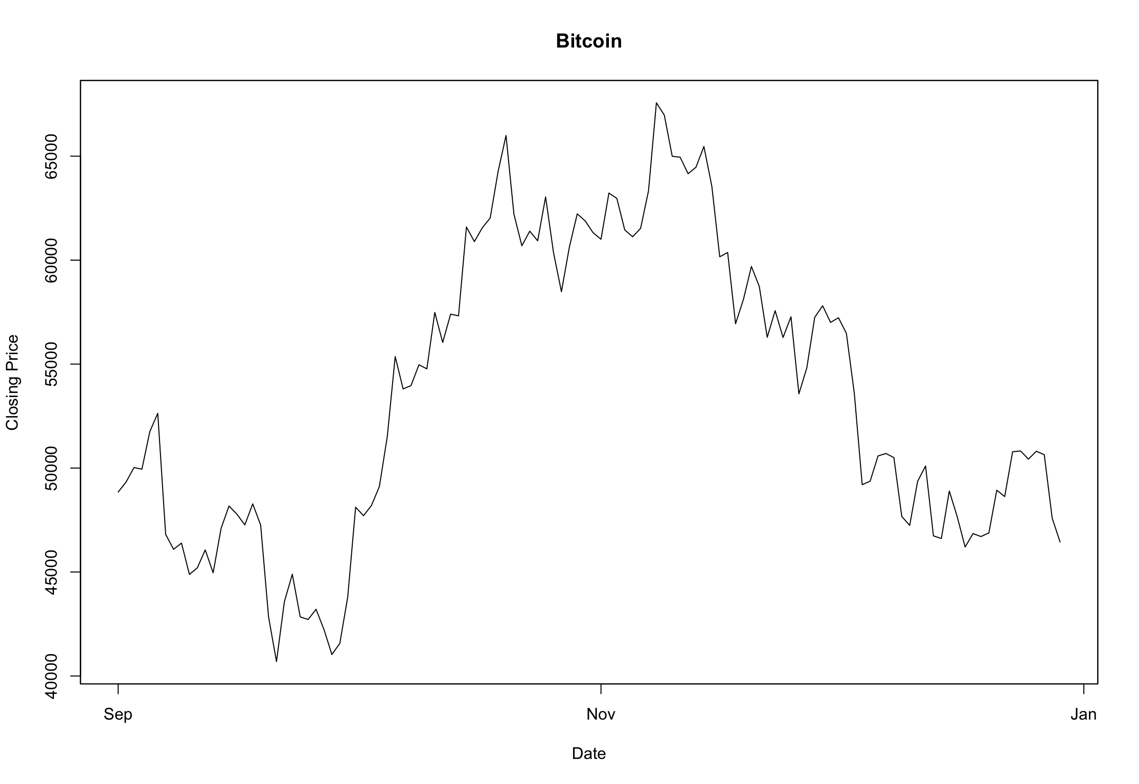
Introduction to Time Series Analysis
Time series analysis is a statistical method used to analyze data collected over time.
In the context of Bitcoin, it allows us to understand and predict the daily closing prices based on historical data.

Slide 7
Data Overview
Source of the data
coinmarketcap.com
Selected Variable
Daily closing prices
Timeline
Sep. 1^{st,} 2021 to Jan. 9^{th,} 2022.
To assess the model's predictive performance, the subsequent 10 days from 31/01/2022 to 09/01/2022 were designated as the test data period. During this phase, the model's ability to forecast Bitcoin's daily closing prices was evaluated against the actual observed values.

Slide 8
Data Plot over the Period

Slide 9
Models for Time Series Analysis
Initial Consideration: Regression Analysis
Regression Model: Initially, we explored a regression model by fitting the data using the formula trend + trend^2. This allowed us to examine the relationship between time and daily closing prices.

Slide 10
Models for Time Series Analysis
Regression Mode
Table of Coefficients: The table presented the coefficients, their standard errors (SE), t-values, and p-values. Notably, the p-values were scrutinized to assess the significance of each coefficient.
Initial Consideration: Regression Analysis

Slide 11
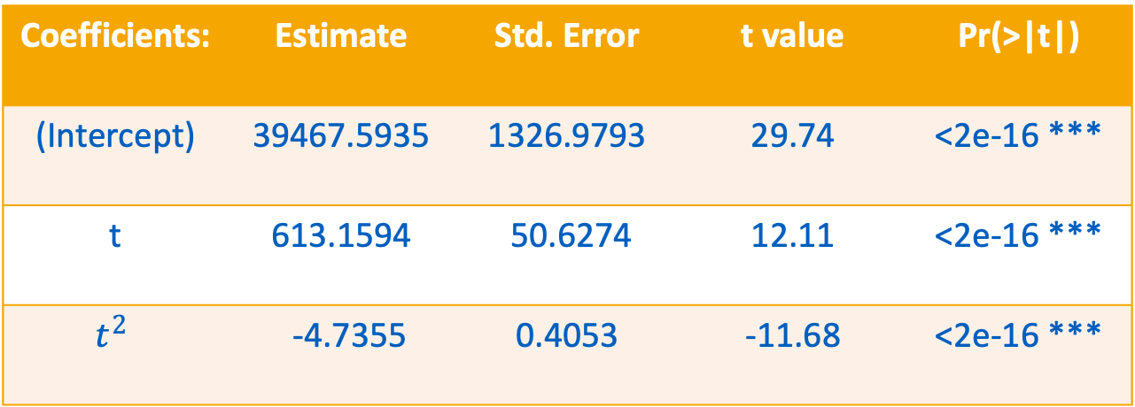
Initial Consideration: Regression Analysis
Table of Coefficients:
Coefficients: | Estimate | Std. Error | t value | Pr(>|t|)
(Intercept) | 39467.5935 | 1326.9793 | 29.74 | <2e-16 ***
t | 613.1594 | 50.6274 | 12.11 | <2e-16 ***
$$t^{2}$$ | -4.7355 | 0.4053 | -11.68 | <2e-16 ***
Residual standard error: 4765 on 117 degrees of freedom
Multiple R-squared: 0.5564
Adjusted R-squared: 0.5488
F-statistic: 73.36 on 2 and 117 DF, p-value: < 2.2e-16

Slide 12
Models for Time Series Analysis
Regression Mode
Table of Coefficients
Residual Analysis: Following the regression fit, we conducted a comprehensive residual analysis. This involved Shapiro and Anderson-Darling normality tests, a QQ plot, and a histogram. These tests aimed to evaluate the assumption of normality and identify any patterns or trends in the residuals.
Initial Consideration: Regression Analysis

Slide 13
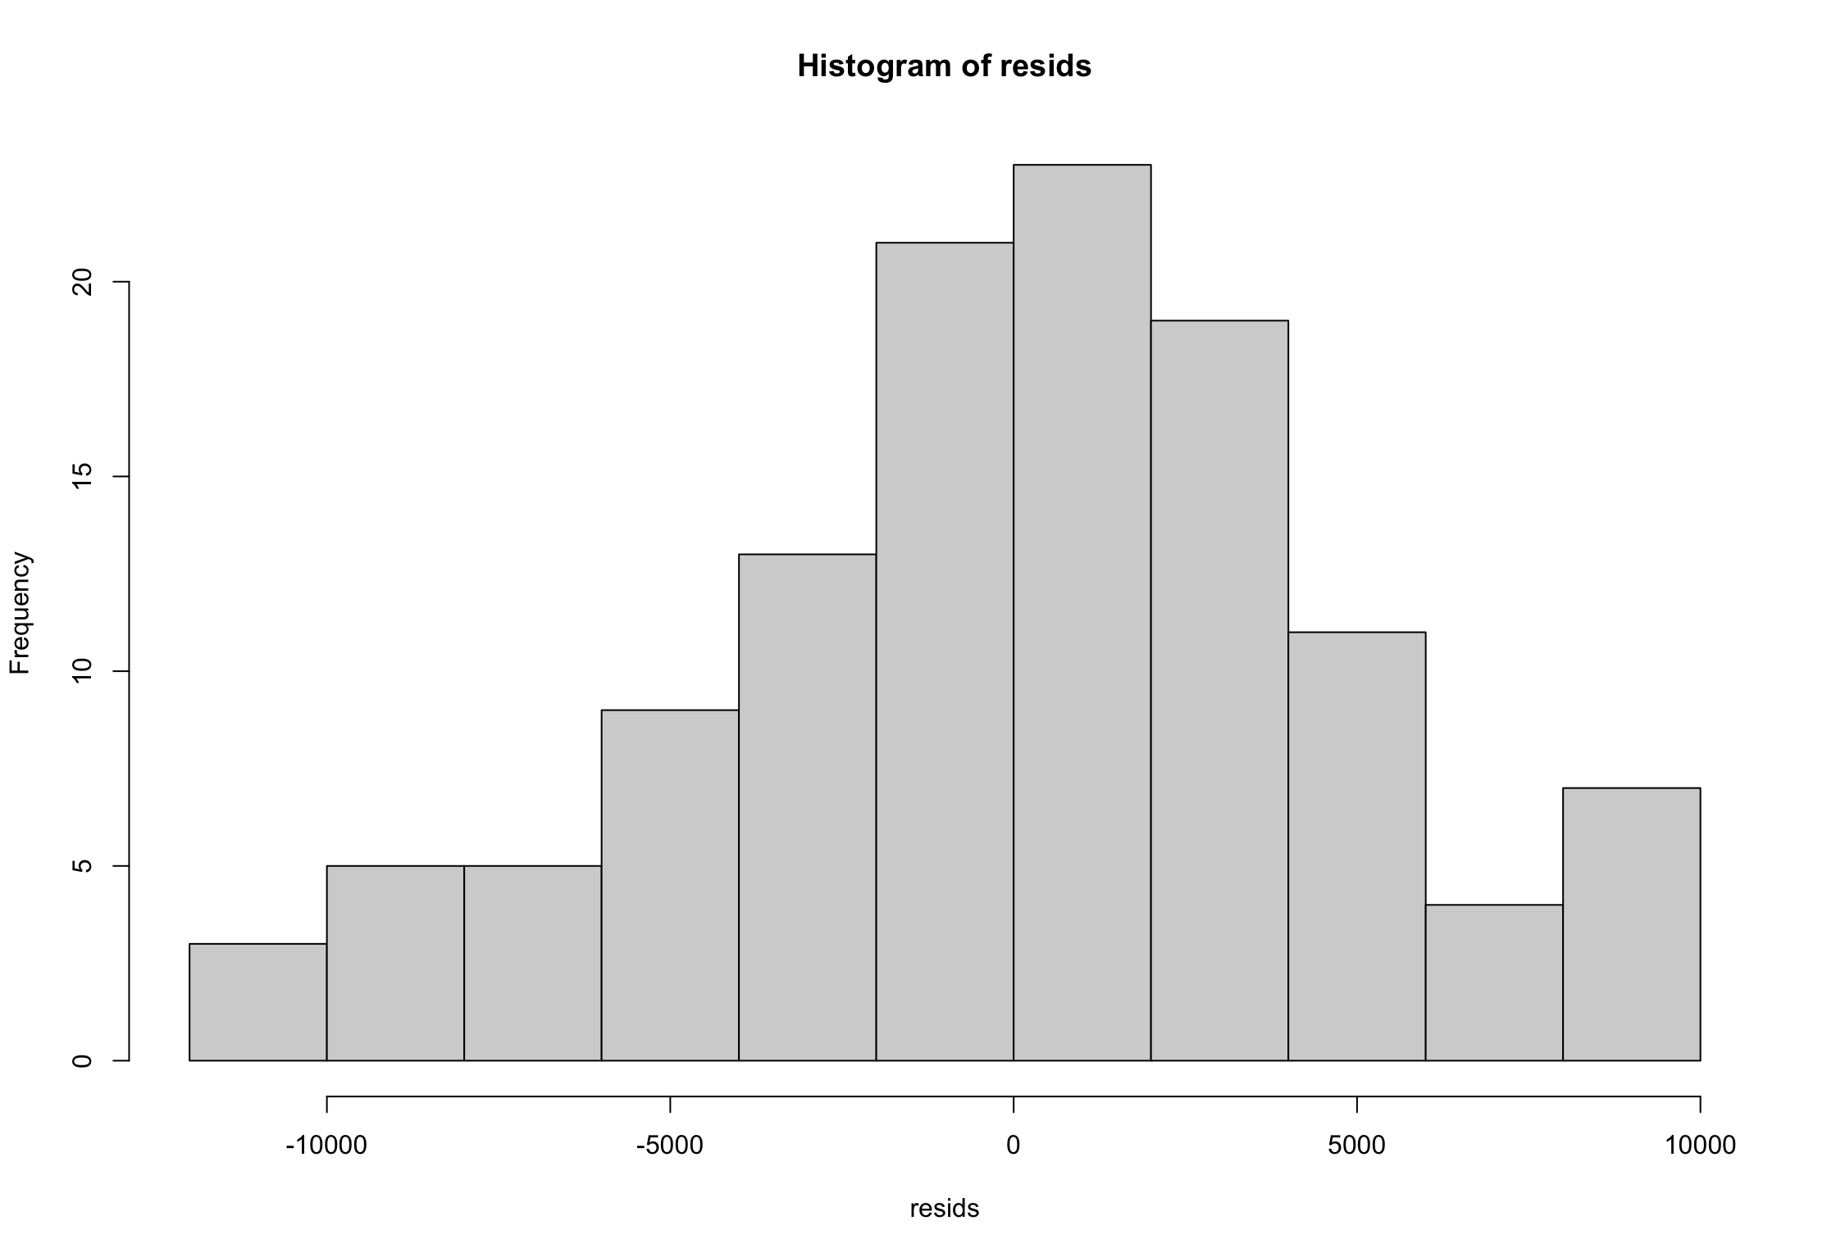
Initial Consideration: Regression Analysis
Residual Analysis

Slide 14
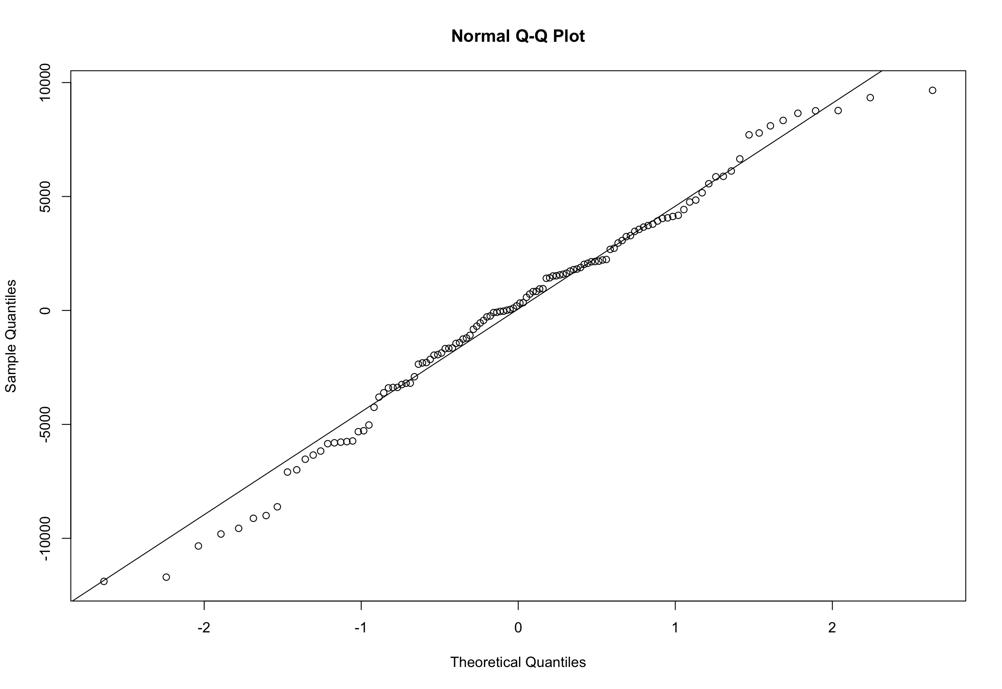
Initial Consideration: Regression Analysis
Residual Analysis

Slide 15
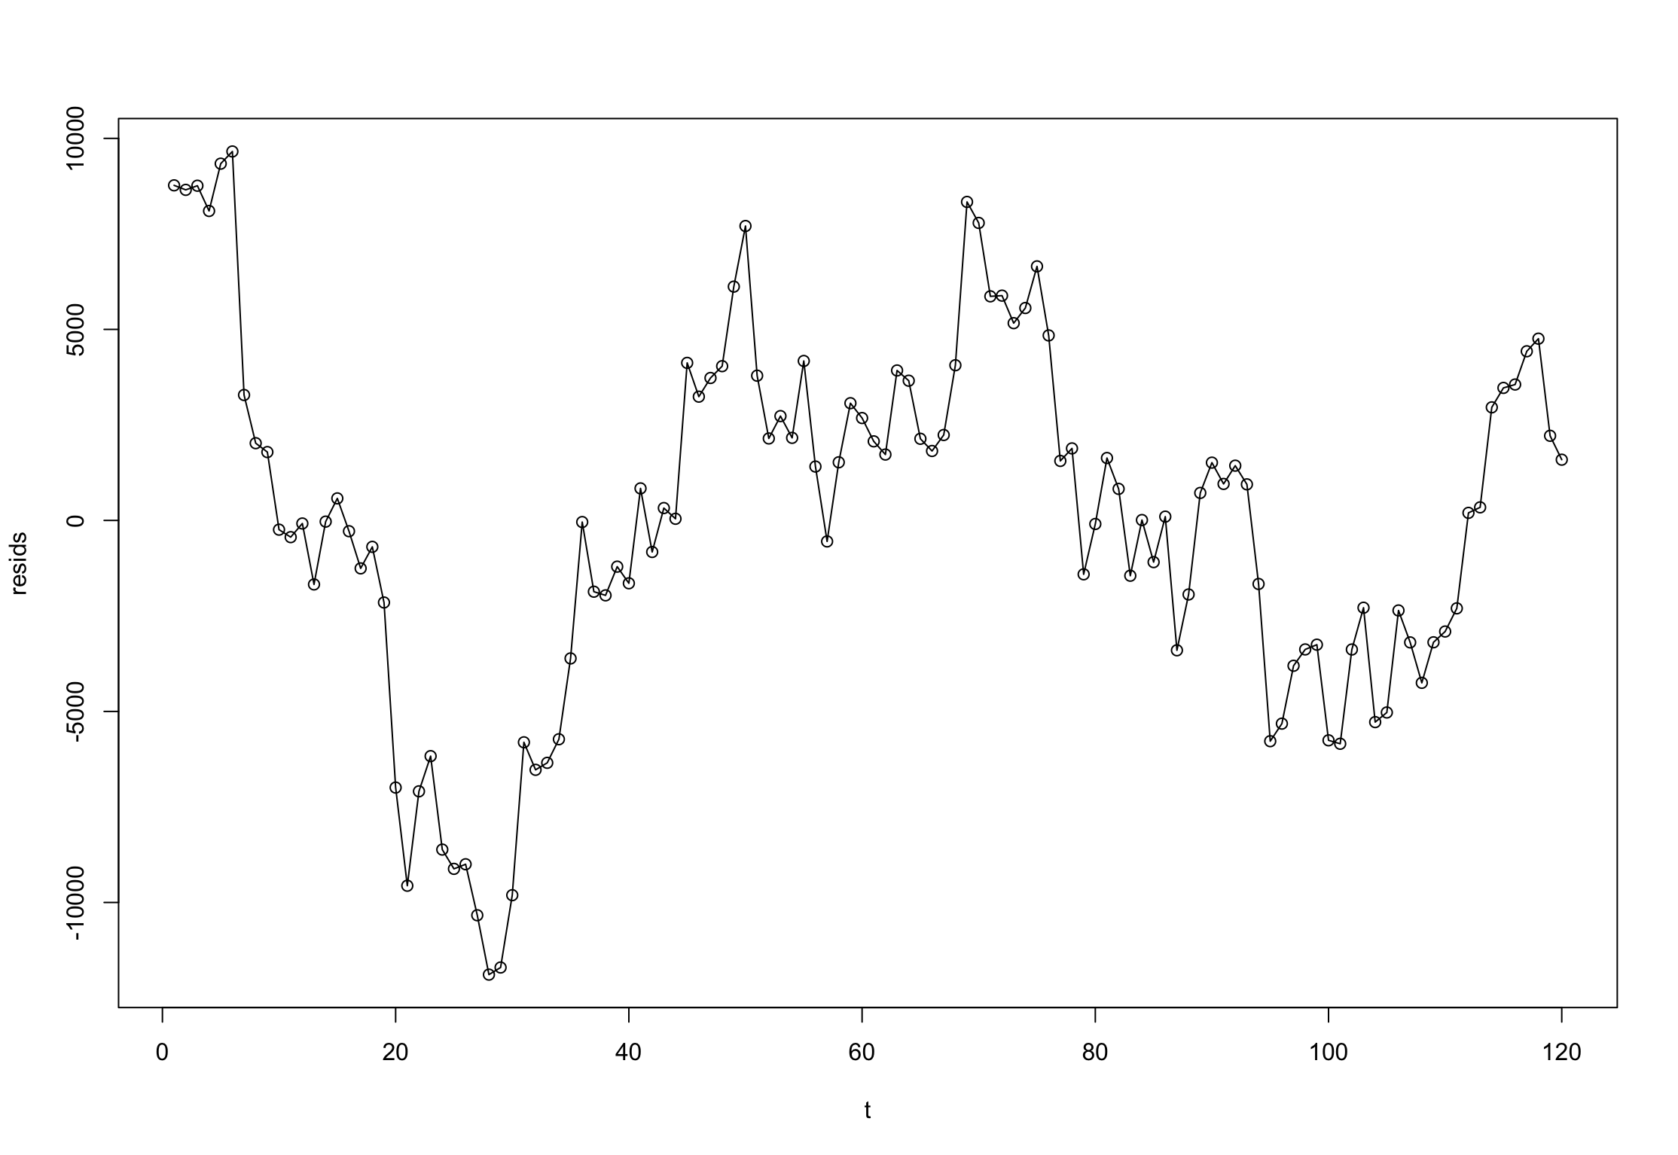
Initial Consideration: Regression Analysis
Residual Analysis

Slide 16
Initial Consideration: Regression Analysis
Residual Analysis
Test | P-Value
Shapiro-Wilk normality test | 0.1795
Anderson-Darling normality test | 0.2214
Runs Test | 7.191e-16

Slide 17
Initial Consideration: Regression Analysis
Residual Analysis
Subdivision into 10 subgroups for further analysis.
Levene test for homogeneity of variance indicated homogeneity.
Time series analysis chosen due to the presence of trends in residuals.
P- value of Levene's Test for Homogeneity of Variance (center = median)
0.002543

Slide 18
Time Series Analysis
Homogeneity of Variance
Levene test on the original data indicated non-homogeneity.
Box-Cox transformation with lambda = 0.1 did not resolve the issue.
Differentiation made the data homogeneous in the variance.
Kruskal-Wallis rank sum test showed a constant mean over time (p-value>0.05).
Tests Results
P-value of Levene test on the original data: 0.01682
P-value of Levene test on the transformed by Box-Cox data: 0.0003461
P-value of Levene test on the differentiated data: 0.7913
P-value of Kruskal-Wallis rank sum test: 0.7717

Slide 19
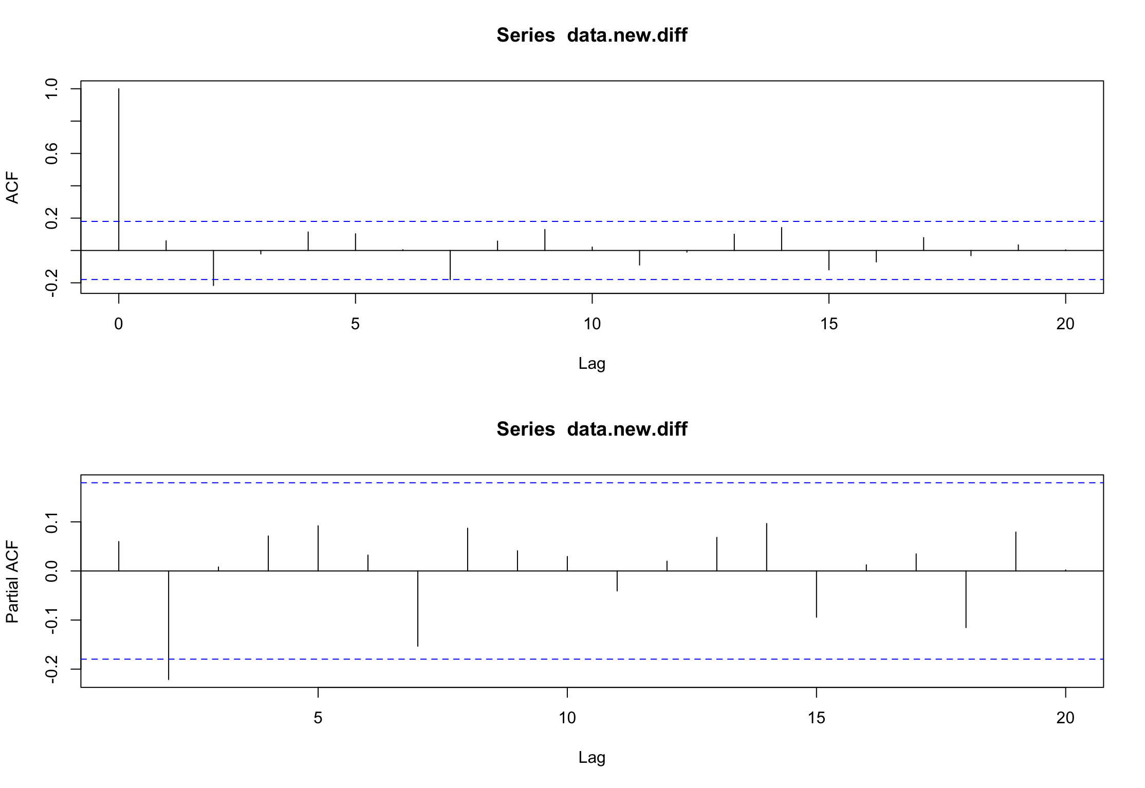
Time Series Analysis
ACF and PACF Analysis
ACF and PACF plots were examined.
Proposed model: ARMA(2,1,0) based on significant lags.

Slide 20
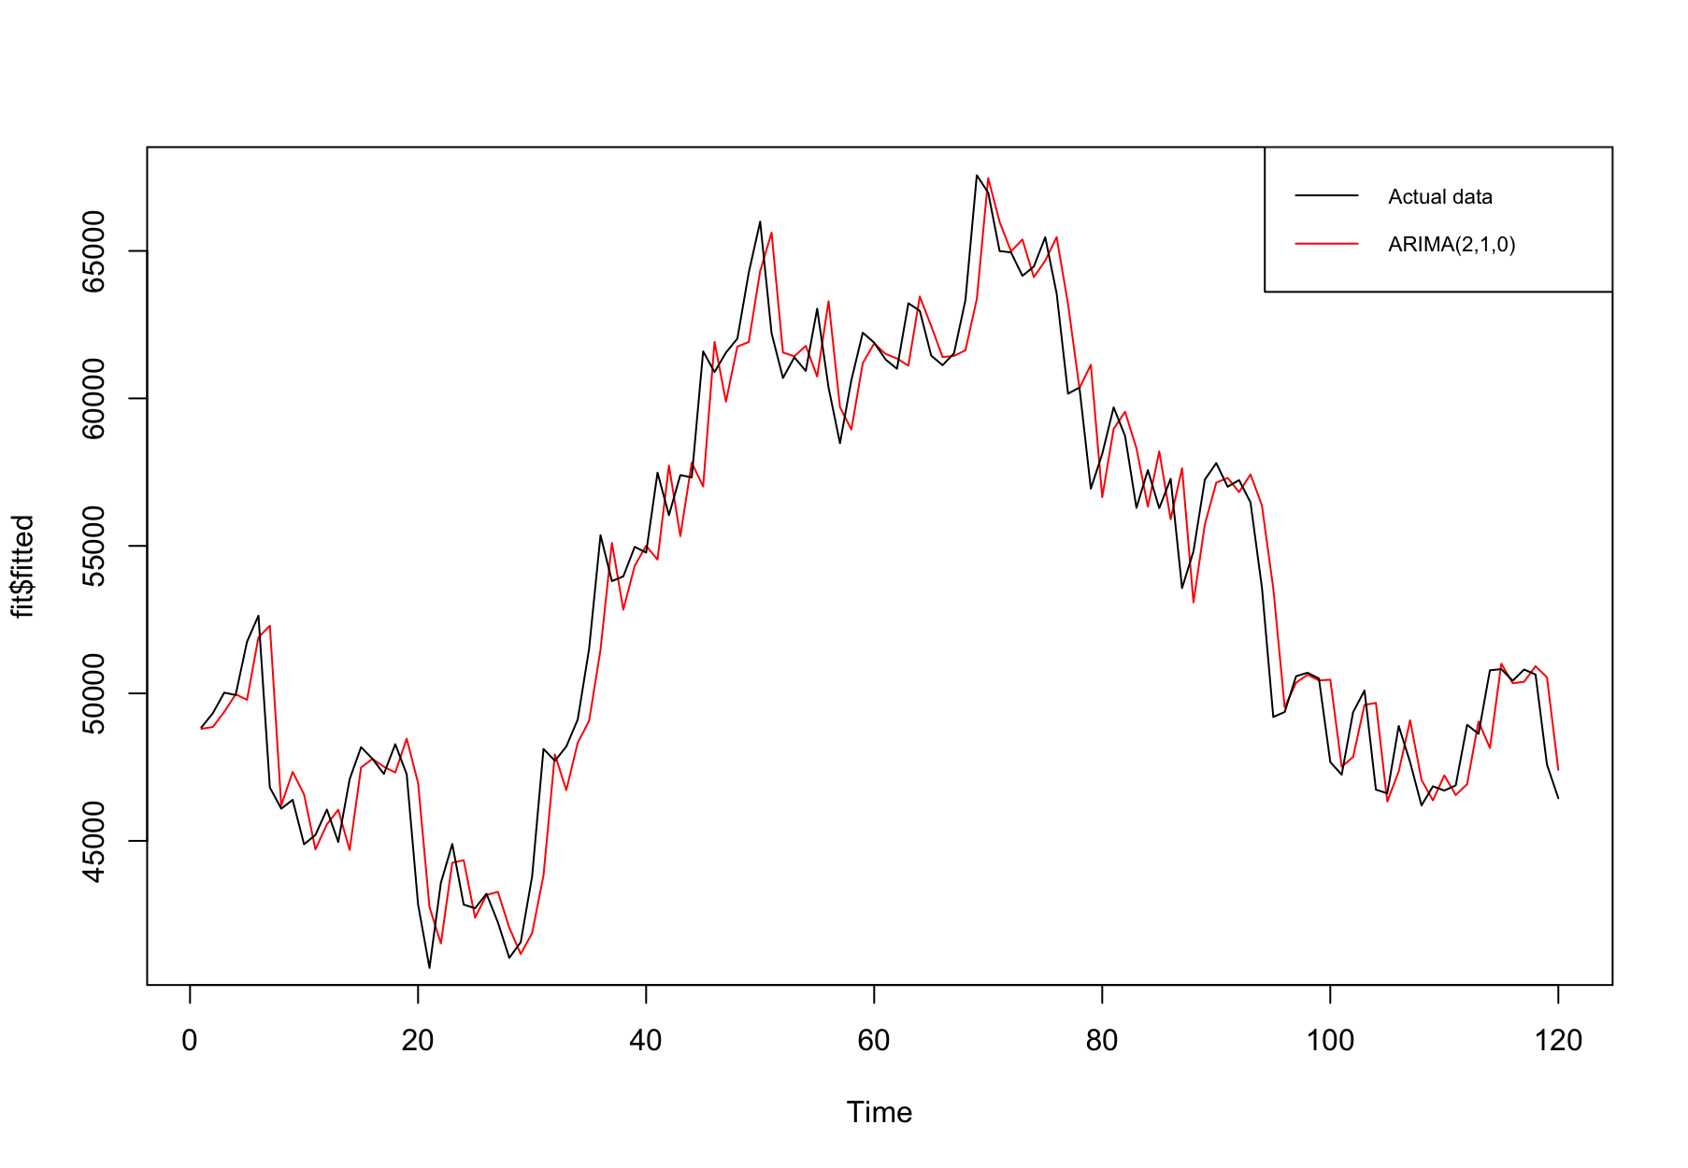
Model Selection
Auto.arima and AICc
Auto.arima code with AICc considered.
Best model selected: ARMA(2,1,0) with optimal parameters.

Slide 21
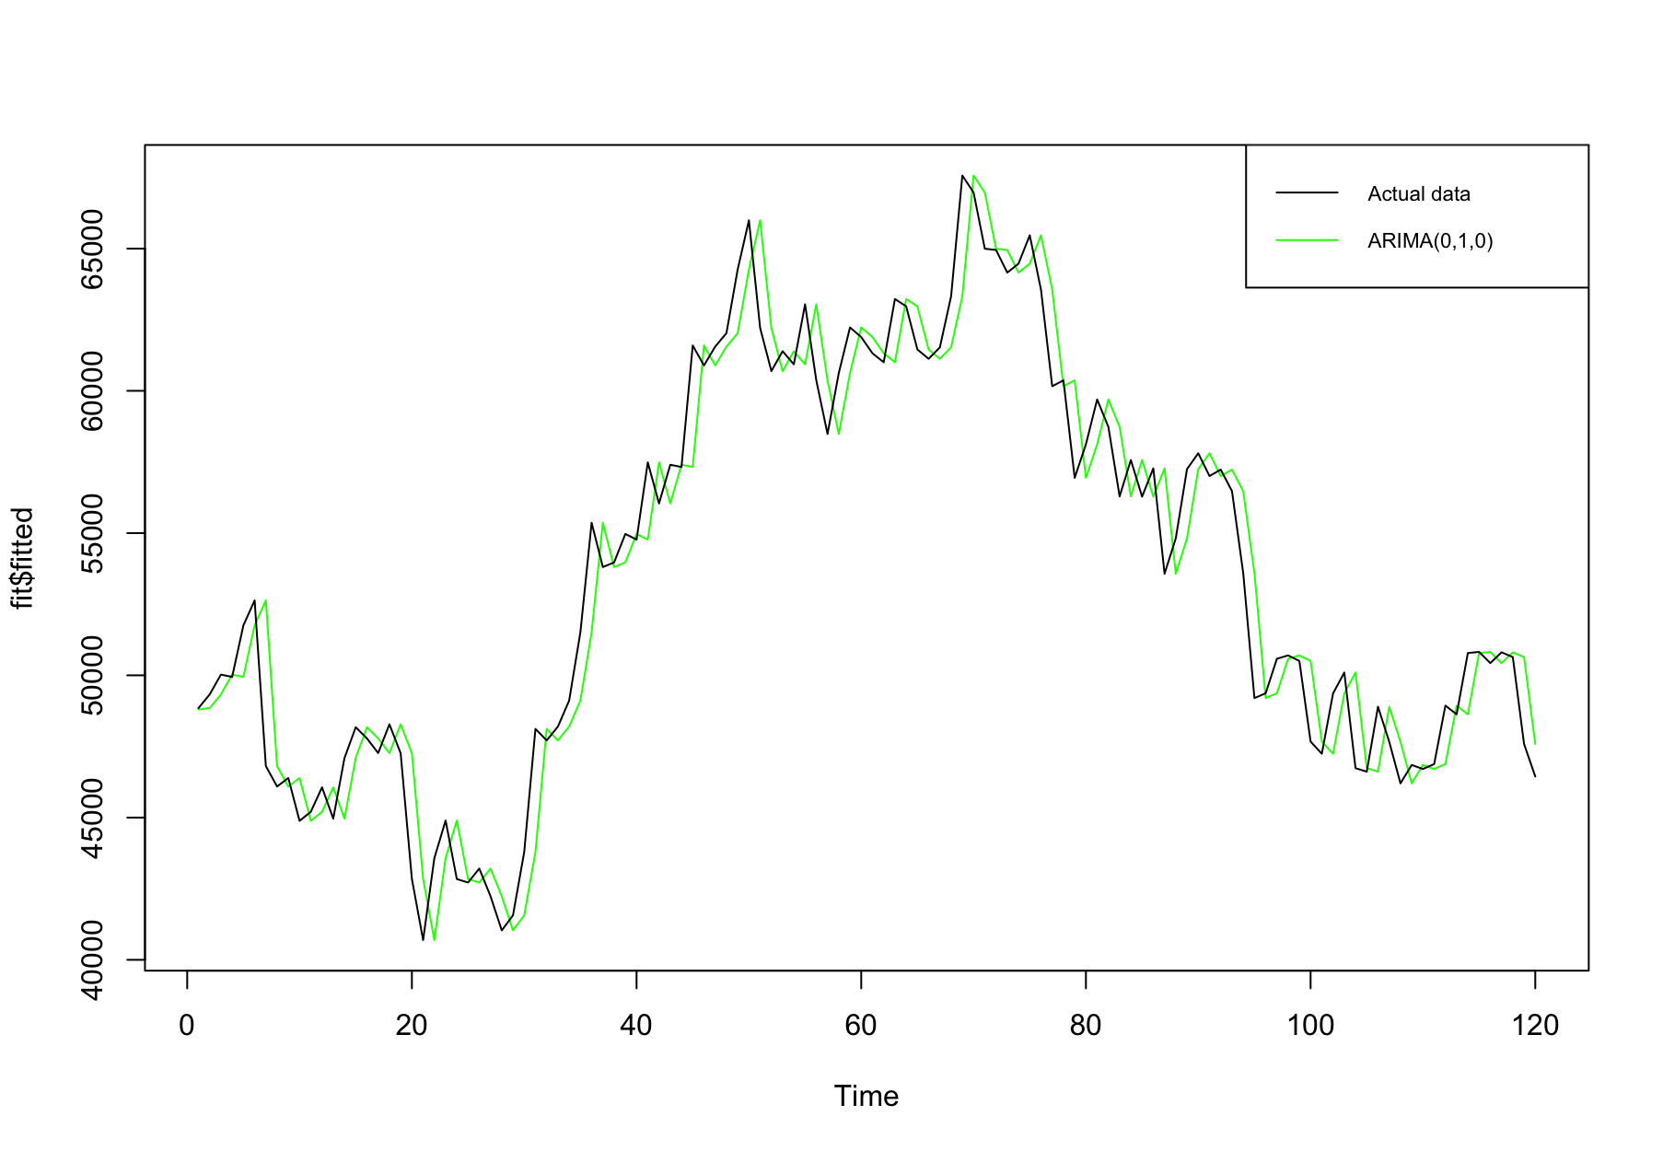
Model Selection
Auto.arima and AICc
Auto.arima code with AICc considered.
Best model selected: ARMA(2,1,0) with optimal parameters.
Auto.arima code with BIC explored.
Best model selected: ARMA(0,1,0) with fewer parameters.
Auto.arima and BIC

Slide 22
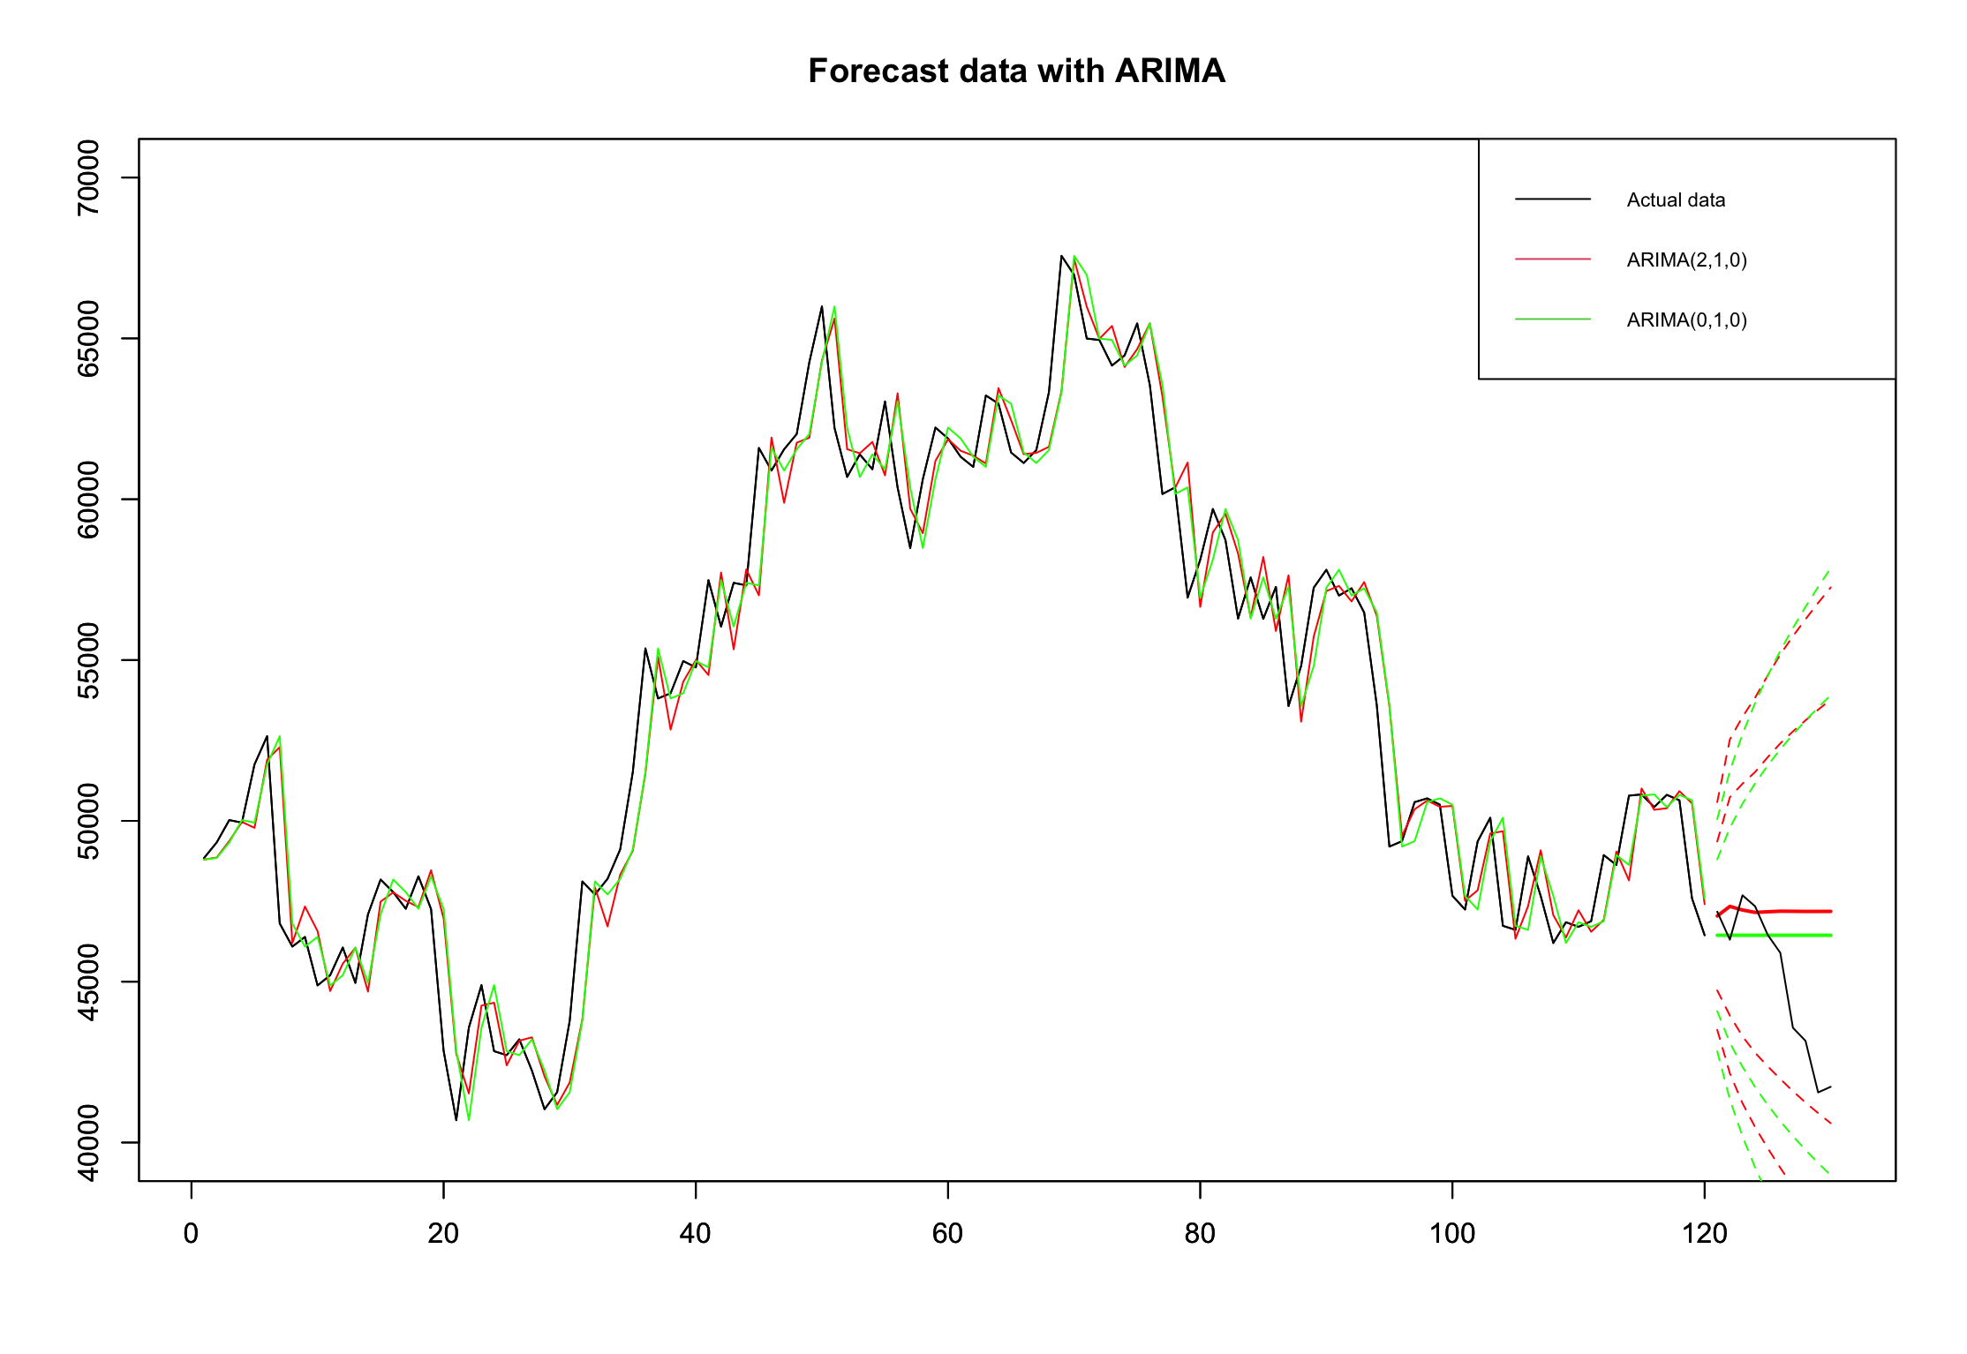
Forecasting
point Forecasts: The model generates point forecasts for each day within the test period, providing an estimate of the expected daily closing prices.
Confidence Intervals (CI):
80% CI: Visualized to show the range within which the actual closing prices are expected to fall with 80% confidence.
95% CI: A wider interval, indicating a higher confidence level, often used for a more conservative estimate.

Slide 23
Forecasting
ARMA(0,1,0)
Point.Forecast | Lo.80 | Hi.80 | Lo.95 | Hi.95 | Actual
47043.58 | 44728.10 | 49359.05 | 43502.37 | 50584.78 | 47178.13
47341.20 | 43948.21 | 50734.19 | 42152.07 | 52530.33 | 46306.45
47228.87 | 43302.58 | 51155.16 | 41224.13 | 53233.61 | 47686.81
47154.54 | 42791.33 | 51517.75 | 40481.59 | 53827.49 | 47345.22
47174.29 | 42370.20 | 51978.38 | 39827.07 | 54521.51 | 46458.12
47192.27 | 41975.25 | 52409.28 | 39213.53 | 55171.01 | 45897.57
47189.14 | 41597.60 | 52780.68 | 38637.62 | 55740.67 | 43569.00
47184.91 | 41244.73 | 53125.09 | 38100.19 | 56269.63 | 43160.93
47185.31 | 40914.42 | 53456.20 | 37594.81 | 56775.81 | 41557.90
47186.28 | 40600.70 | 53771.86 | 37114.50 | 57258.05 | 41733.94

Slide 24
Forecasting
ARMA(2,1,0)
Point.Forecast | Lo.80 | Hi.80 | Lo.95 | Hi.95 | Actual
46444.71 | 44084.85 | 48804.57 | 42835.61 | 50053.81 | 47178.13
46444.71 | 43107.36 | 49782.06 | 41340.67 | 51548.75 | 46306.45
46444.71 | 42357.31 | 50532.11 | 40193.57 | 52695.85 | 47686.81
46444.71 | 41724.98 | 51164.44 | 39226.51 | 53662.91 | 47345.22
46444.71 | 41167.90 | 51721.52 | 38374.52 | 54514.90 | 46458.12
46444.71 | 40664.25 | 52225.17 | 37604.26 | 55285.16 | 45897.57
46444.71 | 40201.10 | 52688.32 | 36895.93 | 55993.49 | 43569.00
46444.71 | 39770.01 | 53119.41 | 36236.64 | 56652.78 | 43160.93
46444.71 | 39365.12 | 53524.30 | 35617.41 | 57272.01 | 41557.90
46444.71 | 38982.17 | 53907.25 | 35031.74 | 57857.68 | 41733.94

Slide 25
Model Evaluation
Table of Estimates: ARMA(2,1,0)
AR Coefficients:
ar1: 0.0712 (SE: 0.0892, t-value: 0.7974, p-value: 0.4268)
ar2: -0.2229 (SE: 0.0898, t-value: -2.4834, p-value: 0.0144)
MA Coefficient:
constant: -15.7278 (SE: 142.9845, t-value: -0.1100, p-value: 0.9126)
Table of Estimates: ARMA(0,1,0)
MA Coefficient:
constant: -20.1876 (SE: 168.7913, t-value: -0.1196, p-value: 0.905)

Slide 26
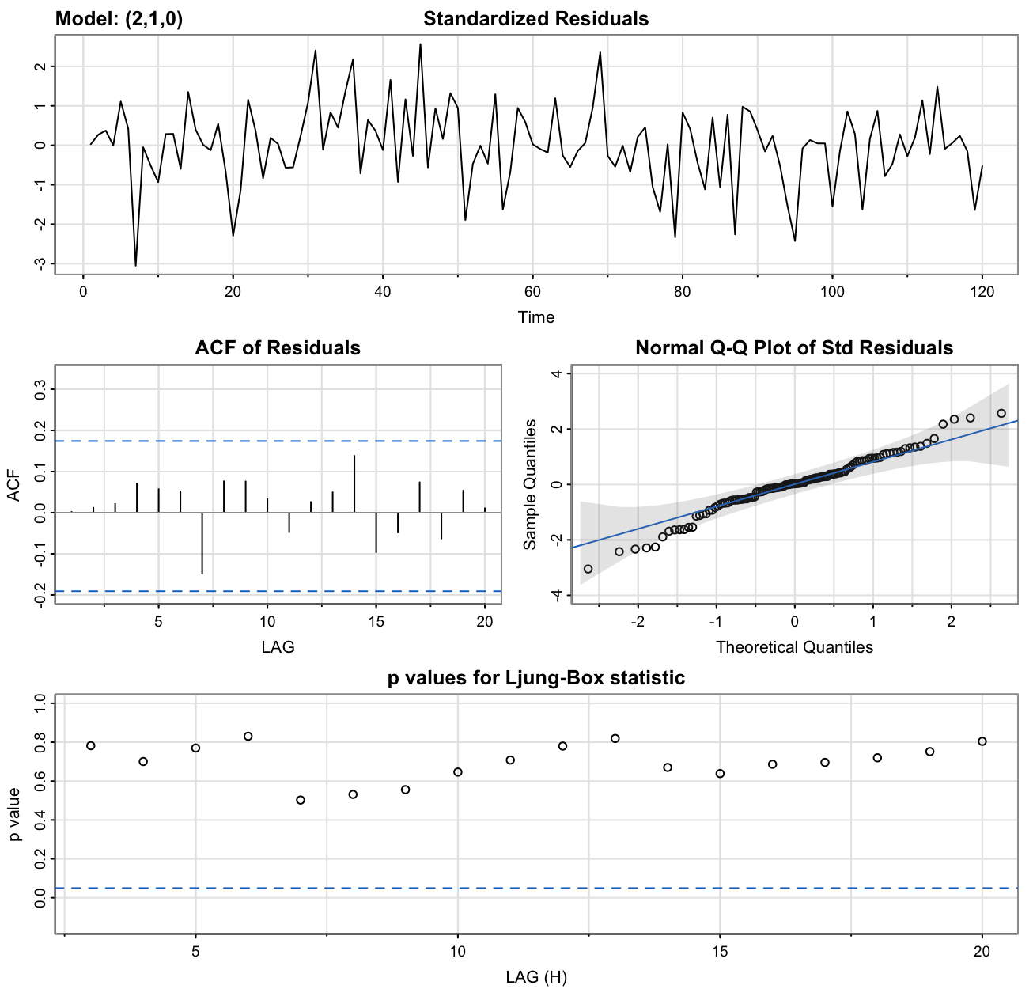
Model Evaluation
Model Assessment: ARMA(2,1,0)
QQ Plot: The QQ plot for the residuals indicates conformity with normal distribution assumptions.
Ljung-Box Statistic: Most p-values for the Ljung-Box statistic are above 0.5, suggesting no significant autocorrelation in residuals.

Slide 27
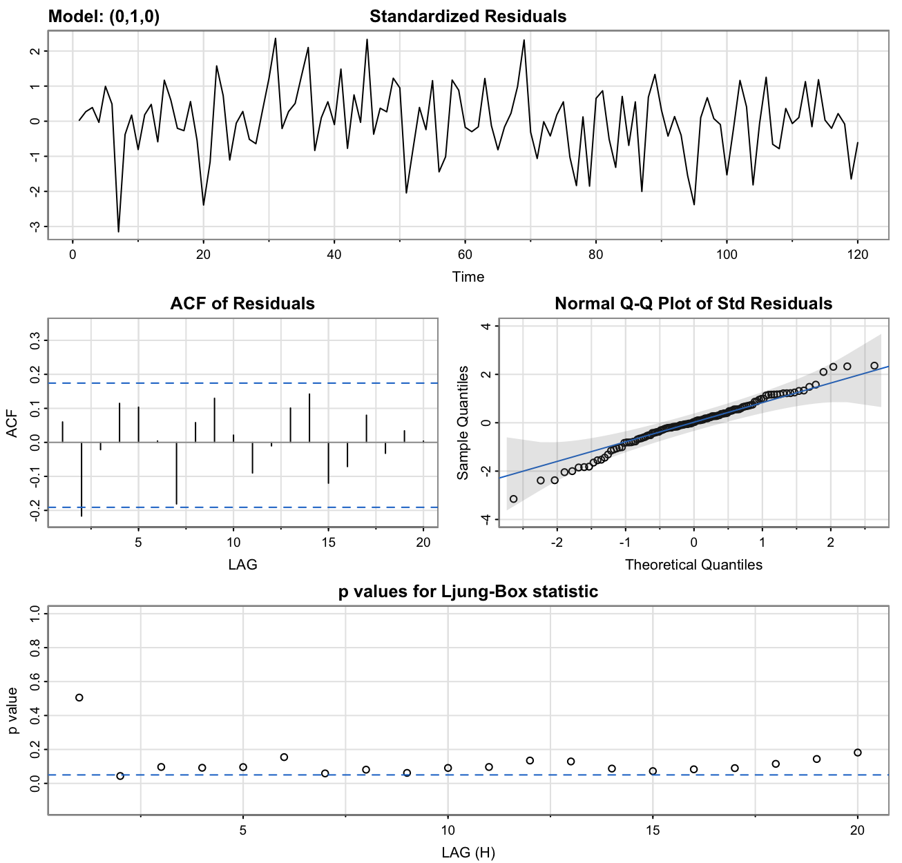
Model Evaluation
Model Assessment: ARMA(0,1,0)
QQ Plot: The QQ plot indicates normal distribution of residuals.
Ljung-Box Statistic: Lower p-values for the Ljung-Box statistic (below 0.2) suggest more significant autocorrelation in residuals compared to ARMA(2,1,0).

Slide 28
Model Evaluation
Conclusion: ARMA(2,1,0)
The ARMA(2,1,0) model demonstrates adequacy in capturing the temporal dependencies in the Bitcoin daily closing prices.
Conclusion: ARMA(0,1,0)
The ARMA(0,1,0) model, while simpler, exhibits more correlated residuals based on the Ljung-Box statistic.

Slide 29
Model Evaluation
Conclusion: ARMA(2,1,0)
The ARMA(2,1,0) model demonstrates adequacy in capturing the temporal dependencies in the Bitcoin daily closing prices.
The residuals appear to be normally distributed, and autocorrelation is not significant based on the Ljung-Box statistic.
Conclusion: ARMA(0,1,0)
The ARMA(0,1,0) model, while simpler, exhibits more correlated residuals based on the Ljung-Box statistic.
The trade-off between model complexity and residual correlation should be carefully considered.

Slide 30
Model Evaluation
Conclusion: ARMA(2,1,0)
The ARMA(2,1,0) model demonstrates adequacy in capturing the temporal dependencies in the Bitcoin daily closing prices.
The residuals appear to be normally distributed, and autocorrelation is not significant based on the Ljung-Box statistic.
Selected based on AICc and Ljung-Box statistic.
Conclusion: ARMA(0,1,0)
The ARMA(0,1,0) model, while simpler, exhibits more correlated residuals based on the Ljung-Box statistic.
The trade-off between model complexity and residual correlation should be carefully considered.
A simpler model based on BIC but with more correlated residuals.

Slide 31
Model Evaluation
Conclusion: ARMA(2,1,0)
The ARMA(2,1,0) model demonstrates adequacy in capturing the temporal dependencies in the Bitcoin daily closing prices.
The residuals appear to be normally distributed, and autocorrelation is not significant based on the Ljung-Box statistic.
Selected based on AICc and Ljung-Box statistic.
Provides a balance between model complexity and capturing temporal dependencies.
Conclusion: ARMA(0,1,0)
The ARMA(0,1,0) model, while simpler, exhibits more correlated residuals based on the Ljung-Box statistic.
The trade-off between model complexity and residual correlation should be carefully considered.
A simpler model based on BIC but with more correlated residuals.
Considered as an alternative, highlighting the importance of model evaluation metrics in selection.

Slide 32
Conclusion
Summary of Findings
Model Selection: The ARMA(2,1,0) model emerged as the preferred choice, striking a balance between complexity and capturing temporal dependencies.
Residual Analysis: The residuals of the selected model exhibit normal distribution and show no significant autocorrelation based on the Ljung-Box statistic.

Slide 33
Conclusion
Summary of Findings
Model Selection: The ARMA(2,1,0) model emerged as the preferred choice, striking a balance between complexity and capturing temporal dependencies.
Residual Analysis: The residuals of the selected model exhibit normal distribution and show no significant autocorrelation based on the Ljung-Box statistic.
Model Performance
Forecasting Accuracy: The ARMA(2,1,0) model demonstrated effectiveness in predicting Bitcoin daily closing prices during the test period.
Comparison with Simpler Model: The simpler ARMA(0,1,0) model, while having fewer parameters, displayed more correlated residuals, emphasizing the importance of model evaluation metrics.

Slide 34
Conclusion
Summary of Findings
Model Selection
Model Performance
Forecasting Accuracy
Residual Analysis.
Comparison with Simpler Model
Insights Gained
Temporal Dependencies: The selected model successfully captures temporal dependencies in Bitcoin daily closing prices, contributing to a more accurate representation of market dynamics.
Model Generalization: The model's generalization capabilities were evident in its ability to forecast values beyond the training period.

Slide 35


